Slide 1
Chapter 6 Reading to Learn from College Textbooks

Slide 2
Assess Your Strengths and Set Goals
Are you a good reader? Do you understand what you read so that you can explain it to others?
How can you improve your reading abilities and strategies?
What reading materials have you encountered in college?

Slide 3
A Plan for Active Reading
Active reading helps to increase focus, understand more of what you read, and prepare more effectively for tests and exams.
Four steps to active reading:
Previewing
Marking
Reading with concentration
Reviewing

Slide 4

http://drive.google.com/file/d/1NsiylOE03STujPVF5uDiWu9QLESc15i4/view
Notes:
Possible discussion starter questions:
What reading strategies work best for you? How might you vary your reading strategy depending on the class subject?
What do you think it means to read actively? How will reading actively benefit you in your courses?
Why can chunking the information help you retain what you are reading?

Slide 5
Previewing
Previewing is taking a first look at your assigned reading before you really tackle the content.
The purpose is to get the big picture.
Strategies include mapping, outlining, listing, and creating flash cards.
Which previewing strategy do you prefer?

Slide 6
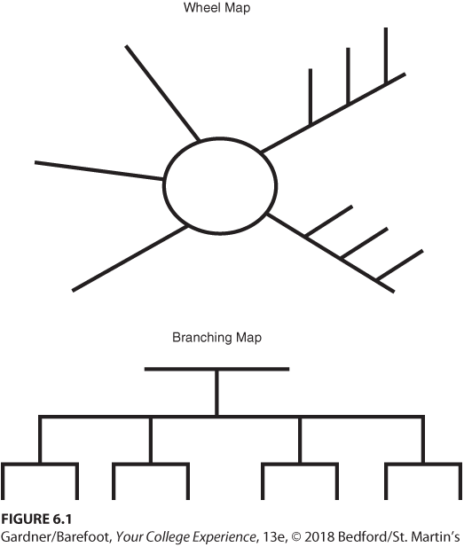
Mapping
Draw a wheel or branching structure.
Show relationships between main and secondary ideas.

Slide 7
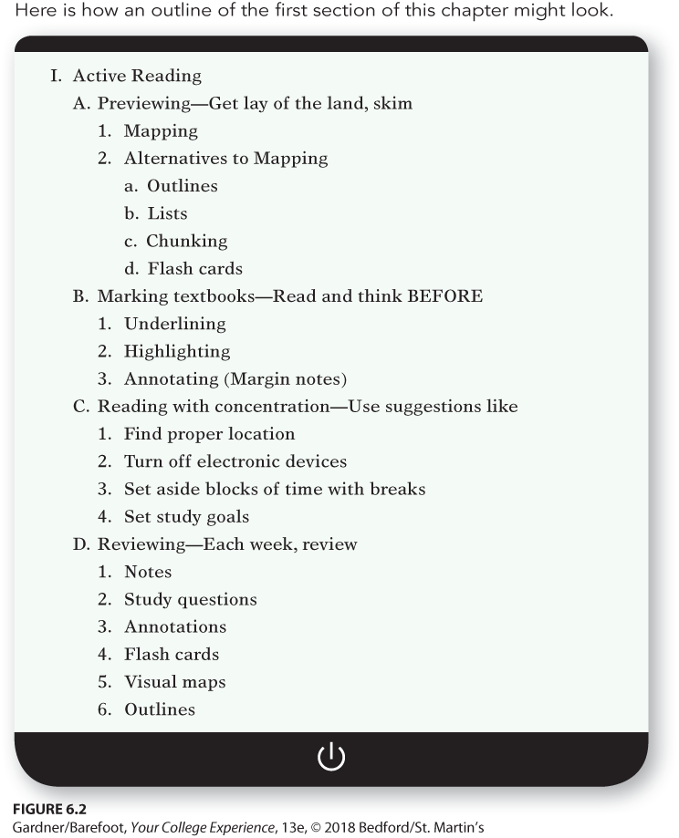
Outlining
Provides a step-by-step visual image
Make an outline of the headings and subheadings in the chapter.

Slide 8
Listing
Effective for dealing with many new terms and definitions
Should be set up with terms in the left column and fill in definitions, descriptions, and examples on the right
Uses chunking

Slide 9
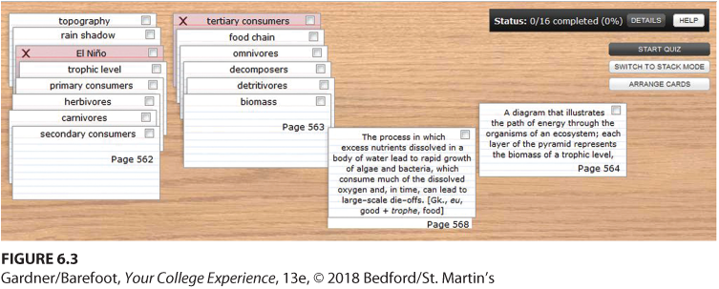
Creating Flash Cards
Portable test questions
Write a question or term on the front of a small card.
Add the answer or definition on the back.

Slide 10
Strategies for Marking Your Textbook
Marking is an active reading strategy that helps you focus and concentrate as you read:
Use your map, outline, list, or flash cards to guide you
Read first without using your pencil or highlighter
Use methods such as underlining, highlighting, and making margin notes or annotations

Slide 11
Reading with Concentration
Students often have trouble concentrating or understanding the content when they read textbooks. Strategies to improve reading ability include:
Finding a quiet place to study
Muting or turning off electronic devices
Reading in blocks of time, with short breaks
Can you name some other strategies?
Notes:
Instructors: Use the question in this slide to generate a class discussion on concentration strategies. Other possible strategies from the chapter include:
Setting goals for your study period
Engaging in physical activity during breaks
Actively engaging with the material
Focusing on the important portions of the text
Understanding the words
Using organizers as you read

Slide 12

Reviewing
Reviewing involves looking through your assigned reading again. Strategies include:
Considering ways to use your senses to review
Reciting aloud
Ticking off each item on a list on your fingers
Notes:
Instructors: Inform students that another reviewing strategy includes posting diagrams, maps, or outlines around your living space so that you will see them often

Slide 13
Improving Your Reading
With effort, you can improve your reading. Some suggestions are:
Connect important ideas by asking yourself: Why am I reading this? and Where does this fit in?
Evaluate the importance and difficulty of the assigned readings.
When the textbook material is the same as the lecture material, save time by concentrating on one or the other.

Slide 14
Monitoring Your Reading
Monitor your reading by asking yourself: “Do I understand this?” (If not, stop and reread.)
After a section, ask, “What are the key ideas?” and “Will I see this on the test?”
After each section, try to guess what information will be presented next.

Slide 15
Developing Your Vocabulary
Notice and write down unfamiliar terms while you preview a text
Think about the context when you come across challenging words
Consider a word’s parts
Notes:
Instructors: Other tips to improve vocabulary include using a glossary or dictionary and using new words in writing and speaking

Slide 16

What If You Fall Behind?
When you fall behind on your reading:
Add one or two hours a day to your study time
Talk to your instructor
Do not give up
Notes:
Other tips include joining a study group and asking for help at a college learning center.

Slide 17
Strategies for Reading Textbooks
Read sections at the beginning to learn more about the author and book structure.
All textbooks are not created equal.
Different disciplines can differ in organization and style of writing.
Textbooks may not provide all the information you want to know.

Slide 18
Math Texts
Work on sample problems and exercises
There are lots of symbols and few words
Material is presented through definitions, theorems, and sample problems

Slide 19
Science Texts
Your approach depends on whether the text is math-based or text-based
Study learning objectives and summaries.
Review the table of contents, glossary, and appendices
Notes:
Other tips for reading science texts include:
Skim material and then look over the end-of-chapter problems before reading the chapter.
It is usually best to outline chapters.

Slide 20
Social Sciences and Humanities Texts
Social sciences textbooks:
Filled with special terms specific to a particular field of study
May include differences in opinions or perspectives
Humanities textbooks:
Provide facts, examples, opinions, and original material such as stories or essays
You will be asked to identify central themes or characters

Slide 21
Supplementary Material
Learn more about a topic by reading primary and supplementary sources referenced in each chapter
Can include journal articles, research papers, original essays
Often refers to concepts familiar to other scholars, but not to first-year college students

Slide 22
Other Strategies
English is one of the most difficult languages to learn. If English is not your first language:
Don’t give up
Take advantage of your college’s services, such as ESL tutoring and workshops:
Notes:
Other strategies for non-native English speakers include:
Reading slowly and reading the material more than once
Having access to an English dictionary and a dictionary that links English with the student’s primary language

Slide 23

Tech Tip: Embrace the E-book
Pros:
Portable and environmentally friendly
Can buy books from almost anywhere
Cons:
Limited or temporary access to some e-books
Can cause eye fatigue
What are some other pros and cons of e-books? Do you prefer traditional books or e-books?
Notes:
Instructors: Use the question in this slide to generate a class discussion on e-books. Other pros and cons listed in the chapter are below.
Pros:
Type notes and highlight text
Print pages with a printer
Access many e-books for free
Backlit screen and adjustable text size
Some have a built-in dictionary
Searchable and shareable
Some have multimedia features and accept audio books
Cons:
Expensive
Breakable
More likely to be stolen than books
Harder to flip through the pages

Slide 24
Reflection
Be sure to practice the four steps of active reading.
It’s easy to say there is not enough time in the day to get everything done. How can you modify your daily activities to make time for reading?

